Slide 1
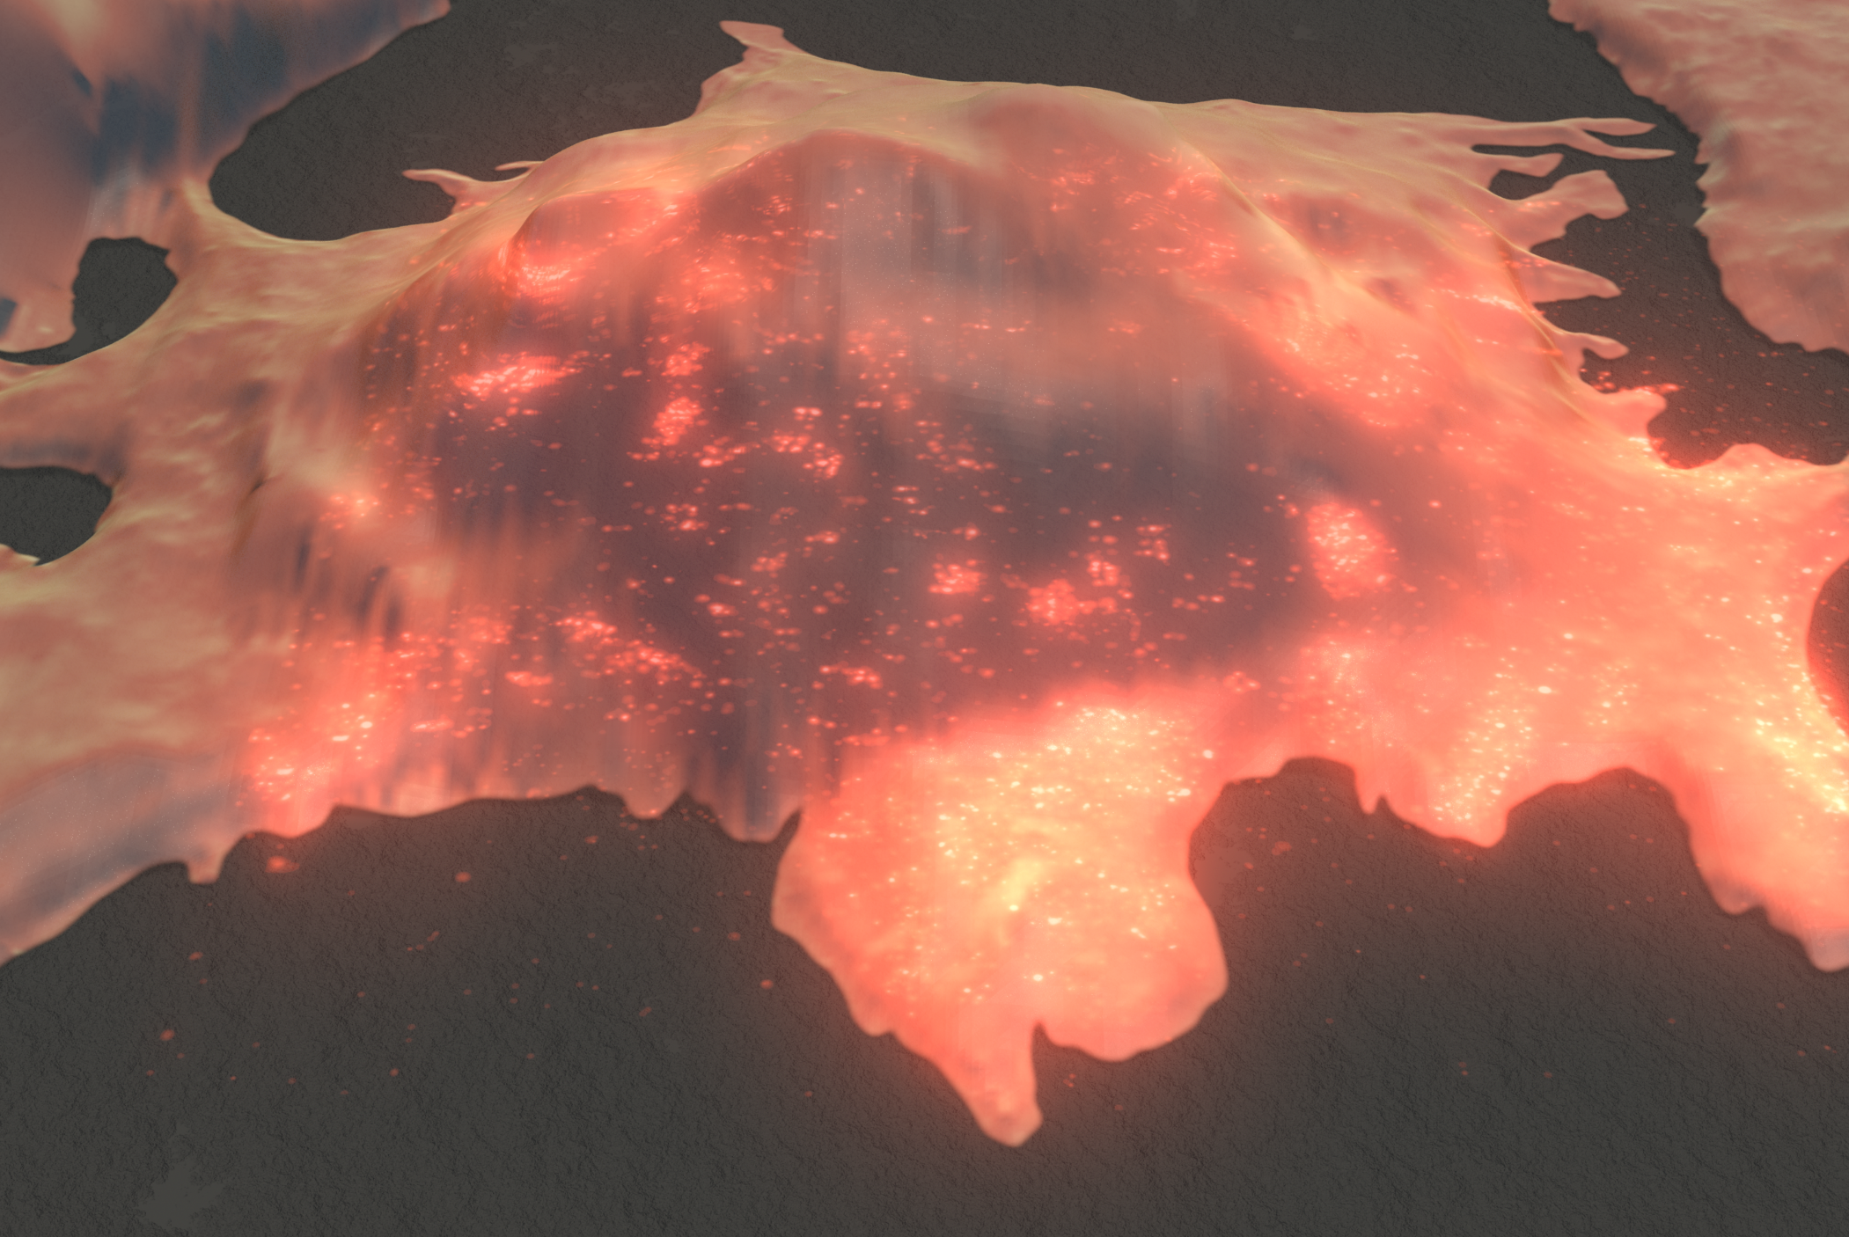
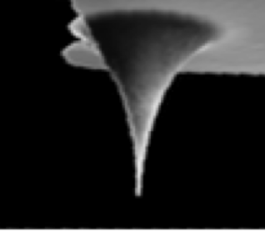
MICRO-428
Georg E. Fantner
Laboratory for Bio- and Nano- Instrumentation
Nanoscale metrology – Part 1: Atomic force microscopy

Slide 2
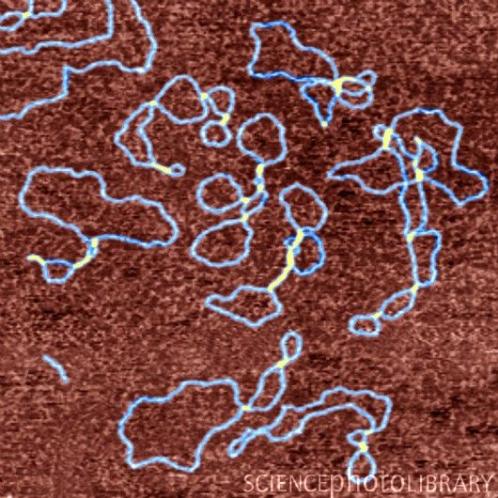
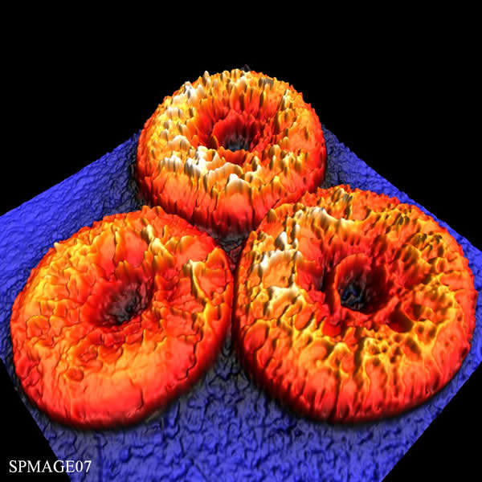
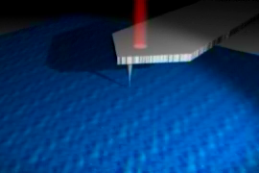
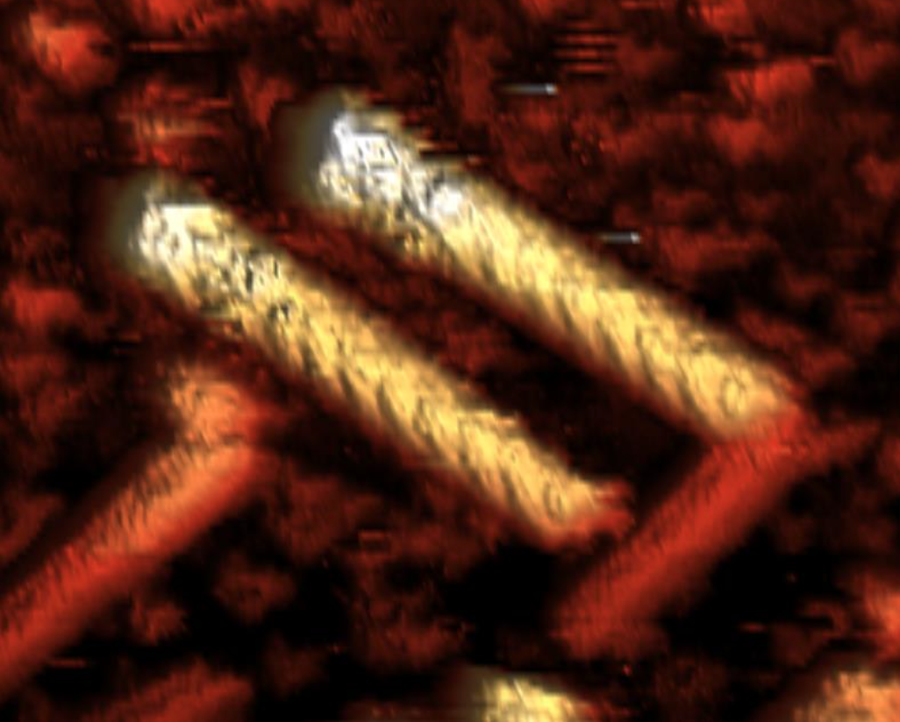
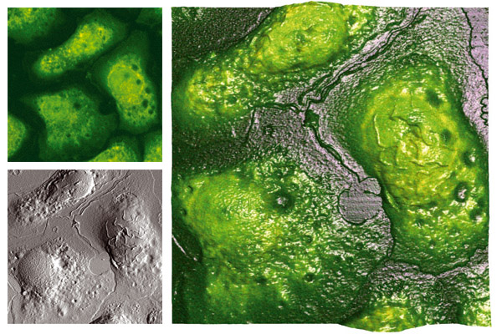
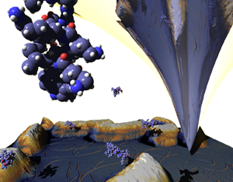
Atomic Force Microscopy
a Versatile Tool for Nanoscale Biology
Single molecule resolution
High resolution imaging in aqueous solution
Nanomanipulation
Single molecule mechanics
Imaging of living cells

Slide 3
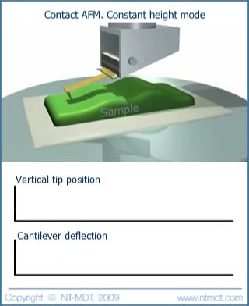
Why do we need feedback?
Constant height mode
Why don’t we just drag the cantilever over the surface?
Cantilever deflection isn’t linear → height measurement is distorted
Force on cantilever is not constant → tip and sample can get damaged

Slide 4
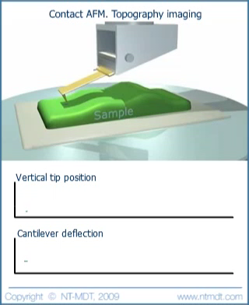
Feedback keeps the tip/sample interaction constant
Benefits of operating in feedback:
Cantilever deflection varies only slightly around setpoint
The amount that the controller has to move the piezo up or down approximates the topography of the sample

Slide 5
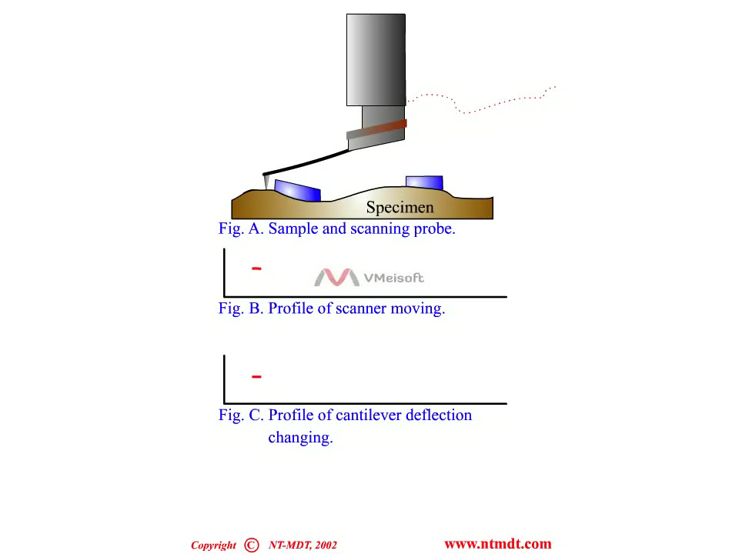
What is the meaning of the error signal?
The deflection/error signal is as much part of the AFM image as the topography image (also called height image)!
It accentuates edges and features with small spatial frequencies
The height image combined with the error image represent the “true topography”

Slide 6
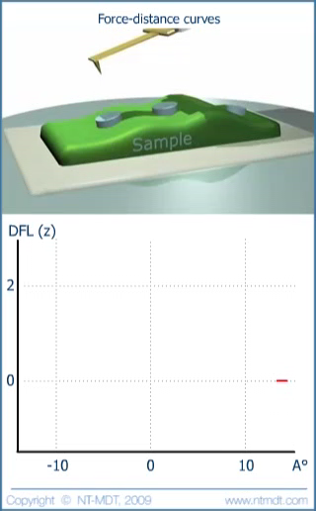
Force curves
Force curves can tell us a lot about the tip sample interaction:
What is the adhesion of tip to sample
What is the hardness of the sample
What is the energy dissipation per cycle
Or about our measurement setup
What is the deflection sensitivity (how many nm do we have to deflect the cantilever to measure 1V shift in the 4-quadrant photodiode)

Slide 7
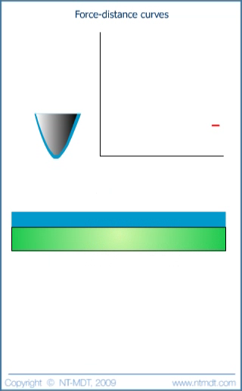
Surface adhesion
Capillary forces are always present when imaging in air!
All surfaces in ambient are covered with a thin water layer.
Capillary forces act between tip and surface
When imaging in air they create a “snap-in” as well as adhesion
They can lead to many artefacts and instabilities

Slide 8
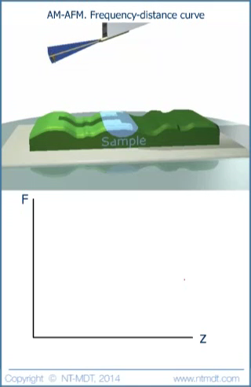
Oscillating approach curves
As the cantilever approaches the surface it feels different forces (due to the Leonard Jones potential)
When the cantilever is in the attractive regime the resonance frequency decreases
When the cantilever is in the repulsive regime the resonance frequency increases

Slide 9
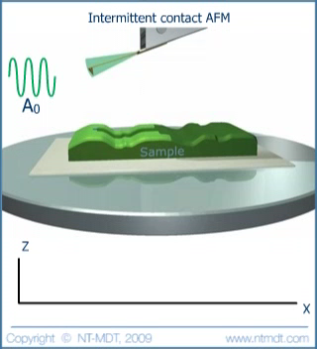
Amplitude modulation
(a.k.a. Tapping mode™)
In tapping mode we excite the cantilever at a fixed frequency ω_{drive} slightly below its resonance frequency
As the cantilever approaches into the repulsive regime, the resonance frequency (of cantilever + sample force) increases.
At the fixed frequency ω, the resulting amplitude will therefore drop as we enter the repulsive regime
The amplitude error is used for the feedback parameter

Slide 10
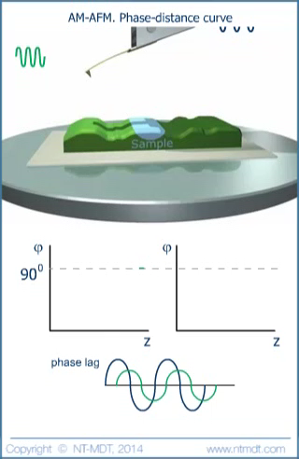
Phase imaging
In tapping mode
The phase signal “represents” the damping that the cantilever feels due to the tip sample interaction
This damping can be due to topography (especially side walls)
Or it could be due to damping by the sample material

Slide 11
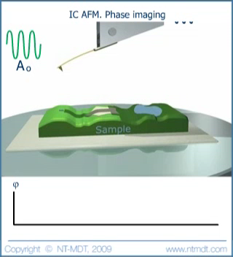
Phase imaging
In tapping mode can give materials contrast
In tapping mode, the phase channel is an additional observable channel
If no topography is present, the phase signal can be used to distinguish materials properties
But beware of interpretation artefacts!

Slide 12
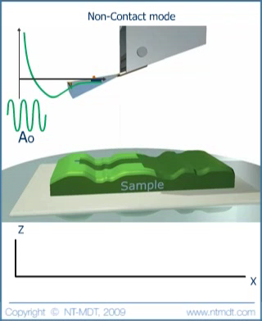
Non contact mode
Imaging in the attractive regime
In non contact mode, the cantilever “never touches” the surface
Non-contact mode is difficult to maintain due to the low forces and small force gradients
Primarily used in vacuum

